Slide 1

Summer School
on real-world crypto and privacy
Sibenik
Responding to the Security and Privacy Challenges Raised by
P4 Medicine
14 June 2018
Jean-Pierre Hubaux
With gratitude to all the biomedical and CS researchers I have the privilege to work with
Notes:
<number>

Slide 2
Outline
P4 Medicine : Personalized, Precision, Participatory, Predictive
Privacy and Security Threats to P4 Medicine
Security and Privacy Notions and Technologies
MedCo: Privacy-Conscious Exploration of Distributed Clinical and Genomic Data
DPPH: Data Protection in Personalized Health
Related Events and Publications
Conclusions and Open Questions
<number>

Slide 3
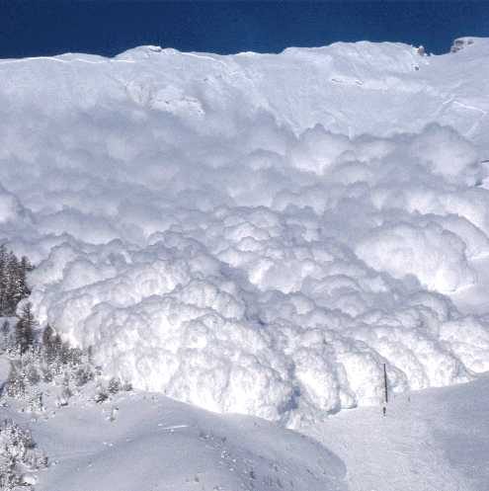
The genomic avalanche Is coming…
<number>

Slide 4
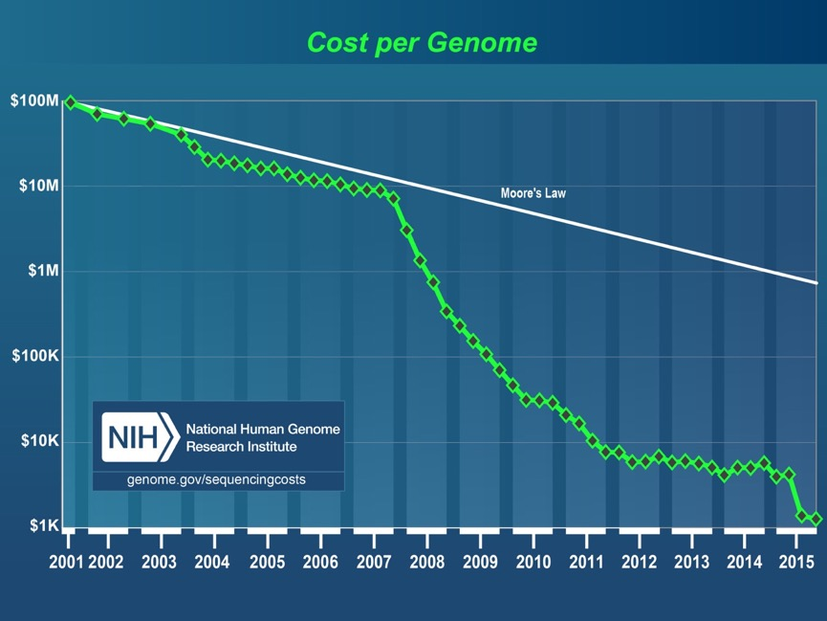
http://www.genome.gov/sequencingcosts/
Notes:
<number>

Slide 5

Medical Use of Genetics
Genetic disease risk tests help early diagnosis of serious diseases
Pharmacogenomics ➔ personalized medicine
<number>

Slide 6
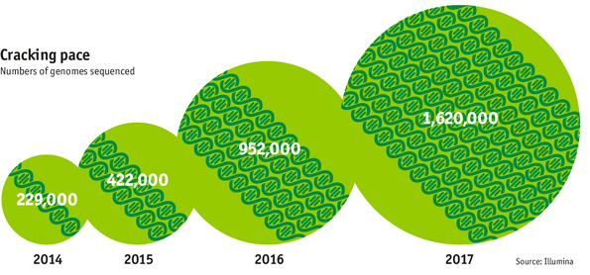
The Genomic Era
<number>
Figure from The Economist

Slide 7
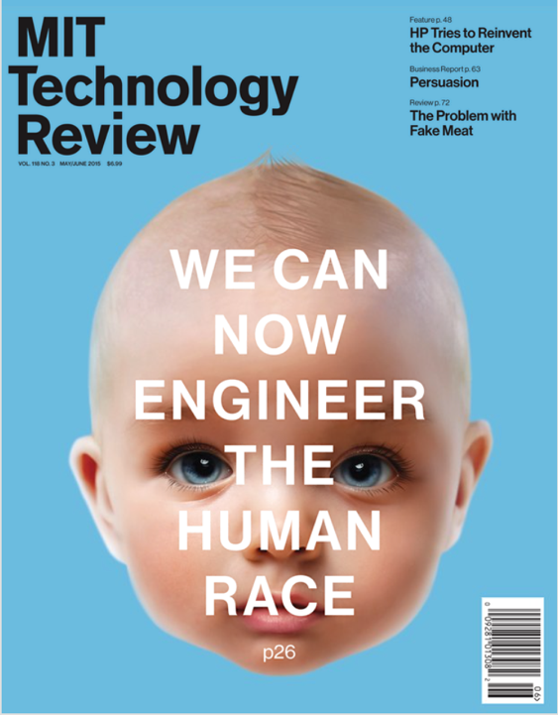
<number>

Slide 8

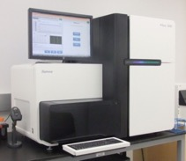
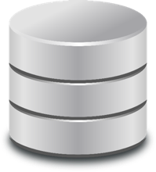
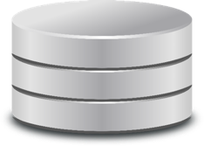
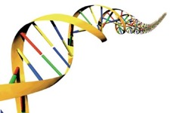
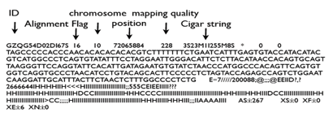
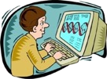
From Blood Sample to Genome Analysis
Raw data
(short reads)
FastQ files
Samples
Sequencing machine
Alignment
Variant call
Delta with
respect to
the
reference
genome
SAM/BAM file
(aligned reads)
VCF Files
3 billion letter pairs, with high coverage, to take into account:
Sequencing errors
Possible mutations
<number>

Slide 9
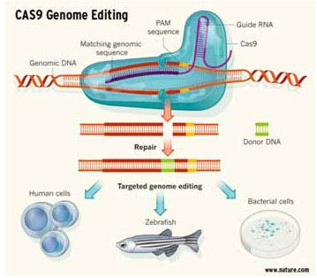
Genome Editing (CRISPR-CAS9)
Potential to alter the human
genome
Strong potential for treatment of
(human) genetic diseases
Moratorium pronounced in
December 2015 for edition of
inheritable parts of the human
genome
Used at least once on monkeys
in China
CRISPR: Clustered regularly interspaced short palindromic repeats
CAS9 is a protein
<number>

Slide 10
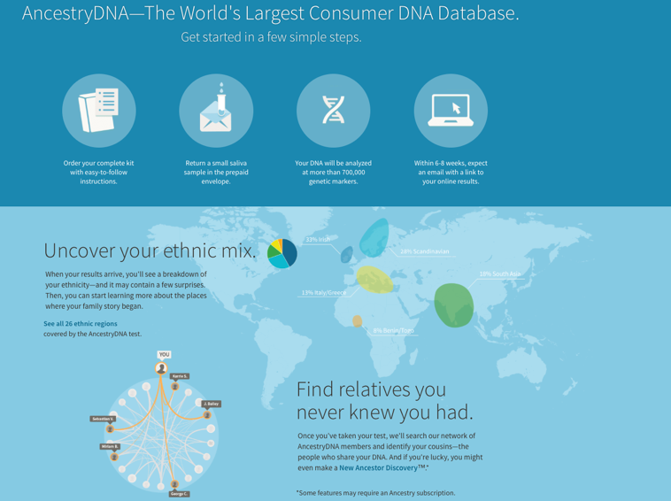
Direct to Consumer Genomics (1/2)
Ancestry.com (1 million+ customers)
© EPFL
<number>

Slide 11

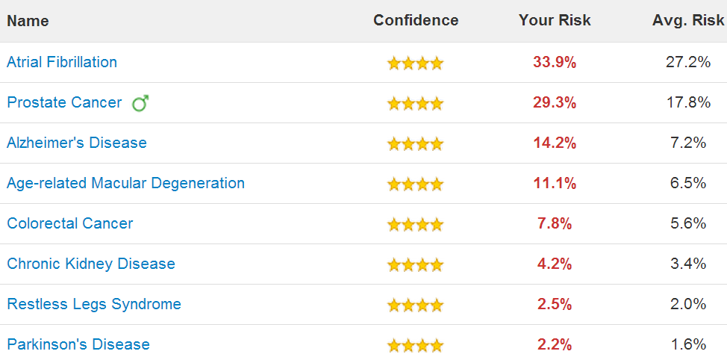
Direct to Consumer Genomics (2/2)
23andMe.com
(1 million+ customers)
© EPFL
<number>

Slide 12
Most common genetic variation:
Single Nucleotide Polymorphism (SNP)
Occurs when, at a specific position, at least a single nucleotide (A,C,G, or T) differs between members of the same species in more than 1% of the population
Potential nucleotides for a SNP are called alleles
2 different alleles can be observed for each SNP:
  Major allele (M)
  Minor allele (m)
Every genome carries 2 alleles at each SNP position
A SNP can be either:
  Homozygous minor [m,m]
  Heterozygous [m,M] or [M,m]
  Homozygous major [M,M]
Individual A
. . .
A | A | G | G | C | C | A | A | C
. . .
A | T | G | G | C | C | A | A | C
Individual B
A | T | G | G | C | C | A | G | C
. . .
. . .
A | T | G | G | C | C | A | G | C
SNP position 2
Alleles: A,T
Major: A
Minor: T
SNP position 8
Alleles: A,G
Major: G
Minor: A
<number>

Slide 13
Alice and Bob:
The Long-Awaited Happy End
After having extensively authenticated each other,
after having exchanged thousands of highly private messages,
after having established numerous secure channels between each other,
after years of intense but platonic relationship, finally, finally…❤️
<number>

Slide 14


… Alice and Bob got closer to each other
Alice
Bob
. . .
A | T | T | G | C | C | G | A | C
. . .
. . .
A | A | T | G | T | C | G | T | C
. . .
C | T | G | G | T | C | A | A | T
C | T | T | G | C | C | A | A | C
Gamete
Production
(spermatozoon)
Gamete
Production
(ovule)
A | T | G | G | C | C | G | A | C
A | A | T | G | C | C | A | T | C
A | A | T | G | C | C | A | T | C
A | T | G | G | C | C | A | A | C
Child
Notes:
<number>

Slide 15
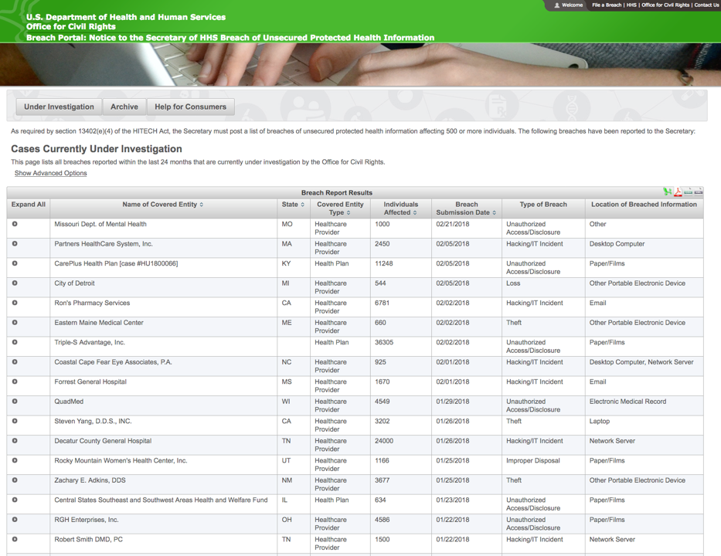
Growing Concern: Medical Data Breaches
Around 5 declared breaches per week, each affecting 500+ people
https://ocrportal.hhs.gov/ocr/breach/breach_report.jsf
<number>

Slide 16
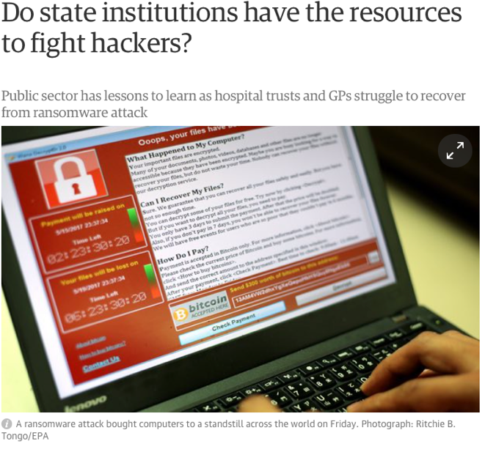
“WannaCry” Ransomware Virus (May 2017)
The Guardian,
14 May 2017
<number>

Slide 17
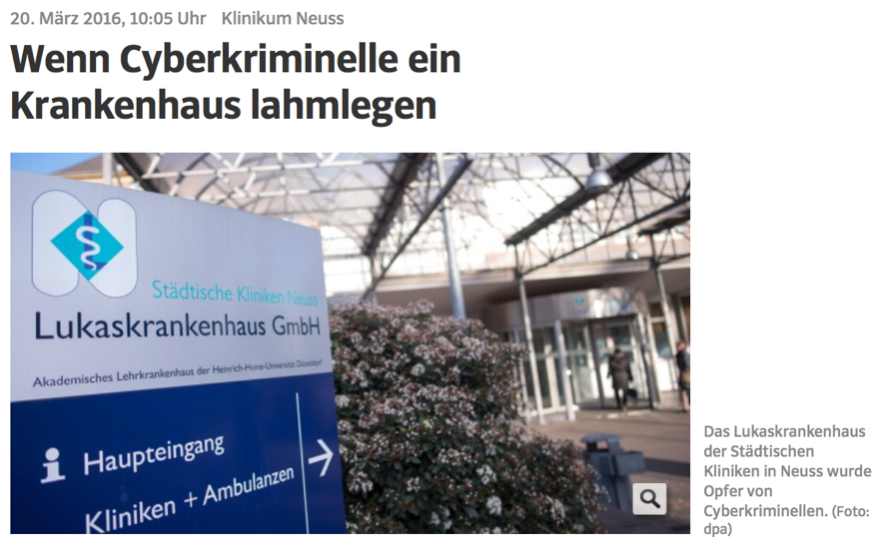
Ransomware Attack against
German Hospitals
<number>

Slide 18
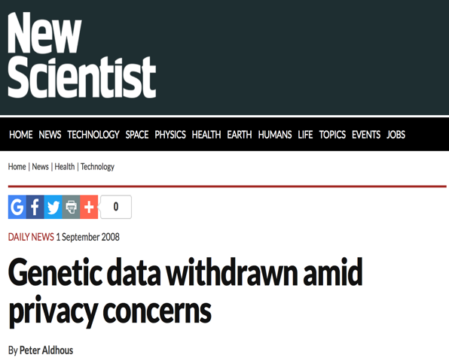
Another Major Concern: Re-identification Attacks against Genomic Databases
<number>

Slide 19
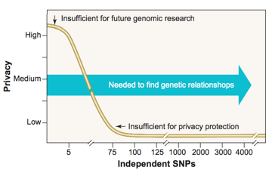

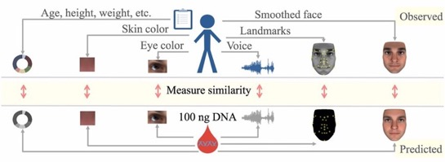
A Plethora of Attacks Against Genomic Privacy
Lin et al. 2004 Science: 75 or more SNPs (Single Nucleotide Polymorphisms) are sufficient to identify a single person
Homer et al. 2008 PLOS Genetics: aggregated genomic data (i.e., allele frequencies) can be used for re-identifying an individual in a case group with a certain disease
Gymrek et al. 2013 Science: surnames can be recovered from personal genomes, linking “anonymous” genomes and public genetic genealogy databases
Lipper et al. 2017 PNAS: Anonymous genomes can also be identified by inferring physical traits and demographic information
Standard de-identification and anonymization techniques are ineffective with genomic data
<number>
Notes:
Standard de-identification and anonymization techniques (data suppression, swapping, obfuscation) are ineffective with genomic data
<number>

Slide 20
Security / Privacy Requirements for
Personalized Health
Pragmatic approach, gradual introduction of new protection tools
Different sensitivity levels of the data
Different access rights
Exploit existing data (electronic health records) and tools
Be future-proof (no short-sighted “bricolage”)
Awareness and enforcement of patient consent
Secure also the collection of health data (via smartphones, wearable sensors,…)
<number>

Slide 21
Security and Privacy Notions
Technologies for Privacy Protection
<number>

Slide 22
Security and Privacy Notions
Security – rightful access to data
    Access control (authentication and authorization)
    Availability (protection against Denial Of Service – DoS attacks)
    Auditability (logging)
    Accountability (verifiability)
    Privacy – rightful use of data following legal imperatives and expressed wishes of the data owner
    Mostly translated into policies
    Difficult to tackle and evaluate in distributed data sharing scenarios
    Consent and terms of use
    Technical protection measures to limit risk (legal compliance)
<number>

Slide 23
Technologies for Privacy and Security Protection
Technology | Properties | Main typical application | Untrusted entity
Traditional Encryption | Standardized and commonly used No processing enabled Vulnerable to quantum cryptanalysis | Protection of data in transit and at rest | External attackers / eavesdroppers
Homomorphic Encryption (HE) | Enables processing without data disclosure Quantum resistance (lattice crypto) Limited versatility when used alone | Private outsourced computation on encrypted data | Processing party
Secure Multiparty Computation (SMC) | Interactive processing of data without disclosure High versatility Online requirement and high bandwidth | Private distributed computation on shared/encrypted data | Processing peers
Secure Hardware (TEE, SGX) | Tamper-proof hardware module Key distribution must be carried out through a secure channel Trust in the hardware manufacturer | Private outsourced computation on encrypted data | Processing party
Differential Privacy | Protects only against re-identification attacks (no further security/privacy guarantees) Reduces data utility | Private data release | Querier
<number>

Slide 24

Deterministic vs Probabilistic Encryption
Deterministic encryption
  Preserves and leaks equality of the the plaintext
  More general property-preserving schemes can focus on other properties (e.g., order, format,…)
Plaintext
Cyphertext
Age
5
5
5
5
5
5
10
10
10
10
Age
TRxZDzVYjV
TRxZDzVYjV
TRxZDzVYjV
TRxZDzVYjV
TRxZDzVYjV
TRxZDzVYjV
kt6gUXGWgL
kt6gUXGWgL
kt6gUXGWgL
kt6gUXGWgL
A value occurs six times
Deterministic Encryption
Another value occurs four times
<number>

Slide 25

Deterministic vs Probabilistic Encryption
Probabilistic encryption
  Random salt added to each encryption to achieve semantic security (plaintext properties are not disclosed, and equality of plaintexts cannot be determined with non-negligible advantage)
  Problem: ciphertexts cannot be compared
Plaintext
Cyphertext
Age
5
5
5
5
5
5
10
10
10
10
Age
LKGM8EUnGd
kt6gUXGWgL
TRxZDzVYjV
IgDwwF64cl
ht5UIk8Evw
kbfRQ2nRAy
R8cBg6KRrw
en0yWX5iWA
mcq3uYOAQA
EE3sF0XfTn
Standard Encryption
<number>

Slide 26





Homomorphic Encryption
$a,b$
$a∘b$
compute ()
encrypt
encrypt
$E\left(a\right),E\left(b\right)$
Compute ()
$E\left(a∘b\right)$
$E\left(a\right)$
$E\left(a∘b\right)$
$E\left(a\right)$
$E\left(b\right)$
$E\left(b\right)$
<number>

Slide 27
Homomorphic Encryption
Homomorphic encryption
  Enables computations directly on encrypted data
  Is probabilistic (semantic security is a requirement for enabling homomorphic computation)
  problem: it can only efficiently enable polynomial operations
<number>

Slide 28
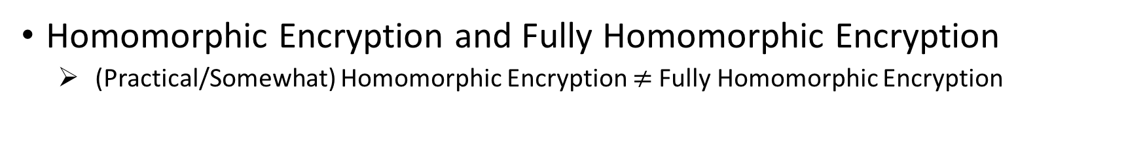
Homomorphic Encryption
Homomorphic Encryption and Fully Homomorphic Encryption
  (Practical/Somewhat) Homomorphic Encryption Fully Homomorphic Encryption
Somewhat Homomorphic Encryption | Fully Homomorphic Encryption (FHE)
Can perform polynomial operations of limited degree | Can perform any operation represented as a binary circuit
Need to set up security parameters tailored for the specific computation | Generic security parameters
Arithmetic circuits and integer inputs | Logical circuits and binary inputs
Constrained computational overhead (several orders of magnitude speed-up w.r.t. FHE) | Very high computational overhead
Expansion controlled by the ciphertext/plaintext cardinality ratio | Very high expansion
<number>

Slide 29
Differential Privacy
De-identification of the data does not protect from inference attacks
  De-identified (redacted) data often contain alternative ways of identification (a.k.a. quasi-identifiers)
  Access to auxiliary information can result in re-identification
Aggregated data are also susceptible to membership and reconstruction attacks
  Given an individual’s DNA, an attacker can infer whether her data was used in a GWAS study*
  Given a dimensionality-reduction function of a dataset (e.g., correlations), an attacker can reconstruct part of the original dataset up to the dimensionality of the results
Facts
  Any useful analysis of personal data must leak some information about individuals
  Leakages accumulate with multiple analyses/releases
*N. Homer, et al. ”Resolving individuals contributing trace amounts of DNA to highly complex mixtures using high-density SNP genotyping microarrays.” PLoS Genet 2008;48:e1000167
<number>

Slide 30

Differential Privacy
Informal notion
  The output of an analysis is similar whether any single individual’s record is included in the database or not
C’s inclusion of her record in the computation does not make her significantly worse of
Analysis
Result
$≈$
Analysis
Result’
If there is already some risk of revealing a secret of C by combining auxiliary information and something learned from DB, then that risk is still there but not significantly increased by C’s participation in the database
<number>
Notes:
<number>
<number>

Slide 31
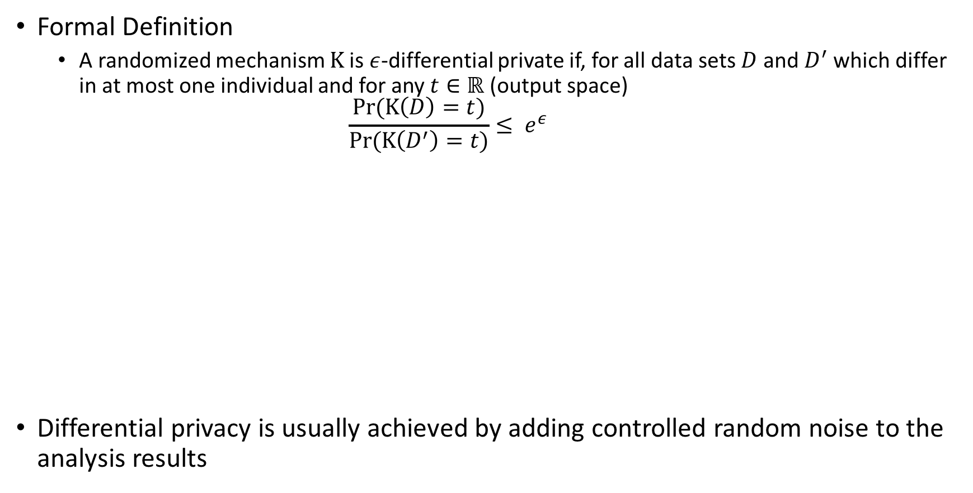
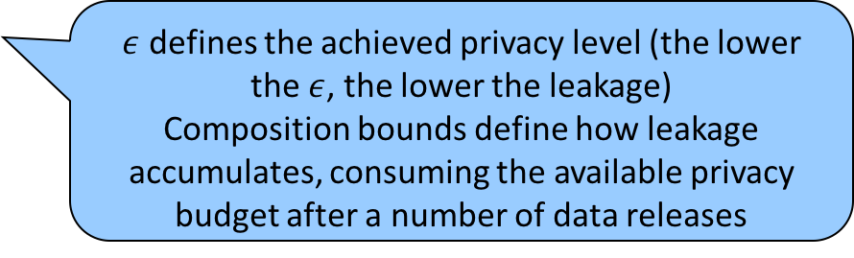
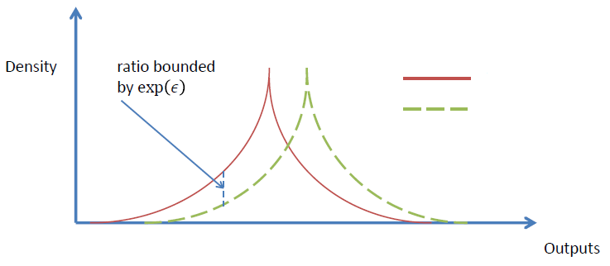




Differential Privacy
Formal Definition
  A randomized mechanism is -differential private if, for all data sets and which differ in at most one individual and for any (output space)
Differential privacy is usually achieved by adding controlled random noise to the analysis results
defines the achieved privacy level (the lower the , the lower the leakage)
Composition bounds define how leakage accumulates, consuming the available privacy budget after a number of data releases
$Κ\left(D\right)$
$Κ\left(D′\right)$
$Κ\left(D′\right)$
$Κ\left(D\right)$
<number>
Notes:
<number>
<number>

Slide 32
MedCo
Enabling Privacy-Conscious Exploration of Distributed Clinical and Genomic Data
<number>

Slide 33










System and Threat Models
Honest-but-curious adversary:
honestly follows the protocol
tries to infer sensitive data from the different steps of the protocol
Site
Site
Site
Query Processing
Malicious-but-covert adversary:
can tamper with the protocol
tries to infer sensitive data from the query end-result
Query
# of Patients
Site
Clinical Research Network
Investigator
<number>

Slide 34


What are the main concerns?
Loss of data confidentiality due to illegitimate access to the data
  External (hacker) or internal (insider) attacker stealing the data
➔ Standard encryption can protect data ONLY at rest or in transit BUT NOT during processing (e.g., in the memory)
Patient re-identification due to legitimate access to the data
  Malicious users performing “smart” data requests in order to re-identify patients in a specific dataset (e.g., patients with HIV)
➔ De-identification or anonymization is ineffective with genomic data
<number>

Slide 35
MecCo: Main Requirements
Functionality:
COUNT(patients)/SELECT(patients)
FROM database
WHERE * AND/OR *
GROUP BY *
Security/Privacy:
  Protection of data confidentiality at rest, in transit and during computation
  no single point of failure
  only the investigator can obtain the query end-result
  (optional) unlinkability
  (optional) differential privacy
* represents any possible concepts in the ontology
<number>

Slide 36












UnLynx: Framework For Privacy-Conscious Data Sharing
Untrusted Collective Authority
Processing Server
Trust is shared across a group of servers forming a collective authority
They collaborate together to generate a collective encryption key
The collective encryption key is used to encrypt the data and can be compromised only if all servers are compromised
Querier
Data Provider 1
Data Provider 6
Data Provider 2
Data Provider 3
Data Provider 5
Data Provider 4
collective authority public key
servers public keys
=
+
+
servers private keys
<number>

Slide 37


UnLynx: Privacy-Preserving Distributed Protocols
Distributed Deterministic Tag (DDT) Protocol:
Det(m₁, )
≠
Det(m₂, )
E(m, )
DDT
Det(m, )
E(m₁, )
≈
E(m₁, )
Distributed Verifiable Shuffling (DVS) Protocol:
{E(m₁, ), E(m₂, ), E(m₃, ), E(m₄, )}
DVS
{E(m₃, ), E(m₂, ), E(m₄, ), E(m₁, )}
Distributed Key Switching (DKS) Protocol:
D(E(m, ), ) = m
DKS
E(m, )
E(m, )
<number>

Slide 38






MedCo: Core Architecture & Protocol
Collective Key
(K₁, k₁)
MedCo Protocol:
A, B) ETL & Encryption Phase
(user) Query Generation
(local) Query Analysis & (distributed) Tagging
(local) Query Processing
(local) Result Aggregation
(local) Result Obfuscation
(distributed) Results Shuffling
(distributed) Results Re-Encryption
(user) Result Decryption
(K₂, k₂)
(K_{i}, k_{i})
(K₃, k₃)
(K_{u}, k_{u})
i2b2
SHRINE
MedCo
ONT: Ontology
ETL: Extract, Transform, Load
CRC: Data Repository (Clinical Research Chart)
Aggr: Broadcast and Aggregator (hub)
<number>

Slide 39
Tests on Clinical Oncology Use Case
Public Data from cBioPortal
121 patients (later scaled to 121,000) with 9 clinical attributes and 1,978 mutations on average per site and patient
Query 1: “Number of patients with skin cutaneous melanoma AND a mutation in BRAF gene affecting the protein at position 600.”
➔ (2 clinical attributes, 4 mutations)
Query 2: “Number of patients with skin cutaneous melanoma AND a mutation in BRAF gene AND a mutation in (PTEN OR CDKN2A OR MAP2K1 OR MAP2K2 genes)”
➔ (2 clinical attributes, 77 mutations)
Hardware and Software Setting
3 servers: 2.5GHz Intel Xeon E5-2680 v3 CPUs with 12 cores
memory: 256GB of RAM
network: 10 Gbps link
OS: Ubuntu
crypto: ElGamal encryption on Ed25519 elliptic curve with 128 bit security
database: PostgreSQL
deployment technology: Docker
(K₁, k₁)
(K₂, k₂)
(K₃, k₃)
<number>
Notes:
<number>

Slide 40
MedCo Demo
https://drive.switch.ch/index.php/s/PAc5ZSnlmlguz83
<number>

Slide 41
Performance Results:
Query Runtime vs. Database Size
Query 1
Query 2
<number>
Notes:
<number>

Slide 42
Performance Results:
Query Runtime vs. Number of Sites
<number>

Slide 43
DPPH
Data Protection in Personalized Health at the Swiss nation-wide scale
<number>

Slide 44

DPPH: Data Protection for Personalized Health
P4 (Predictive, Preventive, Personalized and Participatory) medicine
  Revolutionize healthcare by providing better diagnoses and targeted preventive and therapeutic measures
Challenges:
  Interoperability
  Efficiency and usability in data sharing
  Scalability/Big Data
  Mitigation of privacy risks and compliance with data protection
Centralized vs Distributed Approaches:
Centralized approach (e.g., Human Longevity, Genomics England)
Single point of failure
Impossibility of outsourcing individual patient data
Distributed approach (e.g., Beacon GA4GH, Swiss Personalized Health Network - SPHN)
Distributed trust
Take computation to the data
Decentralization
<number>

Slide 45








DPPH
LCA1: Systems for privacy-conscious data sharing
5 research groups across the ETH domain + SDSC (Swiss Data Science Center)
Funding: 3 Millions CHFrs
Duration: 3 years (4/2018 - 3/2021)
Funding Program: ETH PHRT (Personalized Health and Related Technologies)
Health Ethics and Policy: Legal and Ethical analysis
DEDIS: Distributed and Decentralyzed Trust
DPPH: Data Protection in Personalized Health
SDSC: Data Science Infrastructure and Deployment
GR-JET: Fundamental cryptography
Fellay Group: Medical application
Project goals:
  Address the main privacy, security, scalability, and ethical challenges of data sharing for enabling effective P4 medicine
  Define an optimal balance between usability, scalability and data protection
  Deploy an appropriate set of computing tools
DPPH.CH

Slide 46
DPPH – Work Packages
WP1
Requirements
WP9
Ethics & User Perspectives
WP2
Early Deployment
WP3
Privacy Technology
WP4
Inference Protection
WP5
Trust & Accountability
WP6
Big Data and KM
WP7
Patient Monitoring
WP8
Deployment & Validation
<number>

Slide 47


DDPH: Key Enablers
The integration of the shown tools and frameworks provides crucial benefits for medical research
Renga
Scalable distributed scientific computing infrastructure (SDSC)
Scalability and Reproducibility
Ease querying and aggregating distributed medical data
Accessibility and Usability
Secure and privacy-conscious data sharing and processing for medical data (LCA1)
Privacy and Accountability
Robust support for secure operations on distributed data (DEDIS)
Security and Access Control
Framework for inference risks and countermeasures, and ethical analysis of distributed platforms for medical data sharing
Legal and Ethical compliance
Important note: i2b2, SHRINE and TranSMART are just examples of tools. The DPPH project is tool-agnostic
<number>

Slide 48
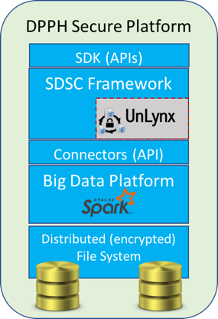
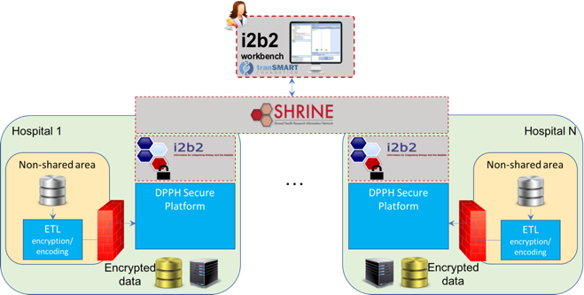
DPPH: Architecture
Platform enabling privacy-conscious data sharing
Modular architecture based on reliable big data technologies
End-to-end protection of shared data: in transit, at rest, and even during processing
Transparent and usable access through the adaptation of
common widespread tools (i2b2/SHRINE)
ETL: Extract, Transform, Load
<number>

Slide 49

Envisioned Nation-Wide Deployment
DCC
Year 2 & 3: tiered deployment, extra functionality
Q2: Which is the survival rate for
cancer patients undergoing a given chemotherapy?
Year 1: small-scale prototype, simple queries
Q1: How many patients with BRCA1 and breast cancer?
<number>

Slide 50
DPPH Preliminary Step: Workshop in January 2018,
hosted by EPFL
Goal: demonstrate the tools we have already developed
Participants from hospitals:
  USB (Marc Strasser): Marko Obradovic (Project Manager/Data Engineer), Thiemo Kellner (DWH and Big Data)
  CHUV (Olivier Michielin): Sylvain Pradervand (Senior Bioinf. Scientist), Marian Caikovski (SW developer)
  HUG (Christian Lovis): Lucien Troillet (SW developer)
  EOC Bellinzona (Fabrizio Barazzoni): Luca Clivio (referente ICT)
Format
  Theoretical and practical sessions
  Interactive discussions and feedback
Findings
  Very positive feedback
  Willingness from the attending hospital representatives to be early adopters of the tools developed in DPPH
<number>

Slide 51
Events and Publications
Genomic Privacy and Security
<number>

Slide 52

Publications in (at least) two Communities
Z. Huang et al: A Privacy-Preserving Solution
for Compressed Storage and Selective Retrieval
of Genomic Data, December 2016
JPH, S. Katzenbeisser and B. Malin Eds.
Sept/Oct. 2017
<number>

Slide 53



Events on Genome Privacy and Security
Dagstuhl seminars on genome privacy and security 2013, 2015
Conference on Genome and Patient Privacy (GaPP)
  March 2016, Stanford School of Medicine
GenoPri: International Workshop on Genome Privacy and Security
  July 2014: Amsterdam (co-located with PETS)
  May 2015: San Jose (co-located with IEEE S&P)
  November 12, 2016: Chicago (co-located with AMIA)
  October 15, 2017: Orlando (co-located with Am. Society
  for Human Genetics (ASHG) and GA4GH)
  October 3, 2018, Basel (co-located with GA4GH)
iDash: integrating Data for Analysis, Anonymization and sHaring (already in previous years)
  October 14, 2017: Orlando
Inst. For Pure and Applied Mathematics (IPAM, UCLA)
Algorithmic Challenges in Protecting Privacy for Biomed Data
10-12 January, 2018
DPPH Workshop, 17 February 2018
➔ Lots of material online
DPPH18.epfl.ch
<number>

Slide 54
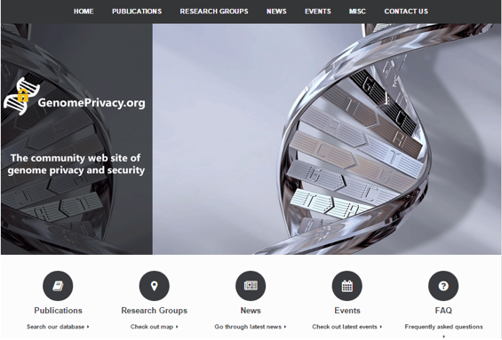

“genomeprivacy.org”
Community website
  Searchable list of publications on genome privacy and security
  News from major media (from Science, Nature, GenomeWeb, etc.)
  Research groups and companies involved
  Tutorial and tools
  Events (past & future)
<number>

Slide 55

Center for Digital Trust (C4DT)
A new initiative of EPFL around data protection, blockchains and cybersecurity
Brings together companies and (EPFL) research labs
Creation announced in December 2017
Should be operational in the fall of 2018
8 organizations associated with the announcement
<number>
Notes:
<number>

Slide 56
Conclusions
Worldwide, the confidentiality of health data is in jeopardy
Effective personalized medicine dramatically scales up the amount of data, involving also *omics data
IoT and ubiquity of wearables collecting health-related data will further increase the risk
The PHRT-funded Project Data Protection for Personalized Health is a response to this concern
<number>
Notes:
<number>

